Slide 1
International Perspectives on Education
Mrs. Manjeena Maria Thomas
Higher Level Maths Tutor (HLMT)
Kingswood Secondary Academy, Corby, Northamptonshire, UK

Slide 2
Number of schools in the UK from 2010/11 to 2021/2022
In 21/22 academic year there were 32, 226 schools in the UK – 524 schools fewer than 10/12. Throughout most of this period there has been a steady decline in the number of schools in the UK.
(Published by D. Clark & 24, 2022)
Notes:
How many schools
How many students
Exponential growth over the coming years

Slide 3
Number of students in the UK from 2010/2022
There were over 10.6 million students attending schools in the United Kingdom in 2021/22, compared with 10.5 million in the previous year and 9.65 million in 2010/11.
(Published by D. Clark & 24, 2022)

Slide 4
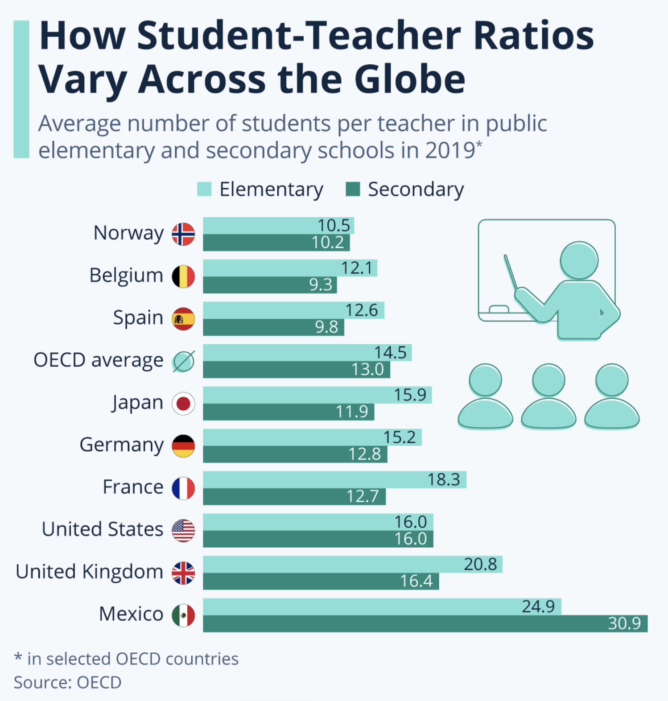
Student-Teacher Ratios Globally
Around the world, schools are struggling to recruit teachers before the start of the school year… as low salaries and burnout from the pandemic are leading to a mass exodus from the profession.
If the situation continues, teaching unions warn, it could lead to a detrimental impact on pupils’ progress, attainment and behaviour.
While the student-staff ratio alone does not guarantee academic success, with teaching styles, teaching methods and extra-curricular choices also as influencing factors, the majority of teachers believe it is important.
(Fleck & Richter, 2022)
Notes:
Could add a slide here about the subjects and hours that are taugh

Slide 5
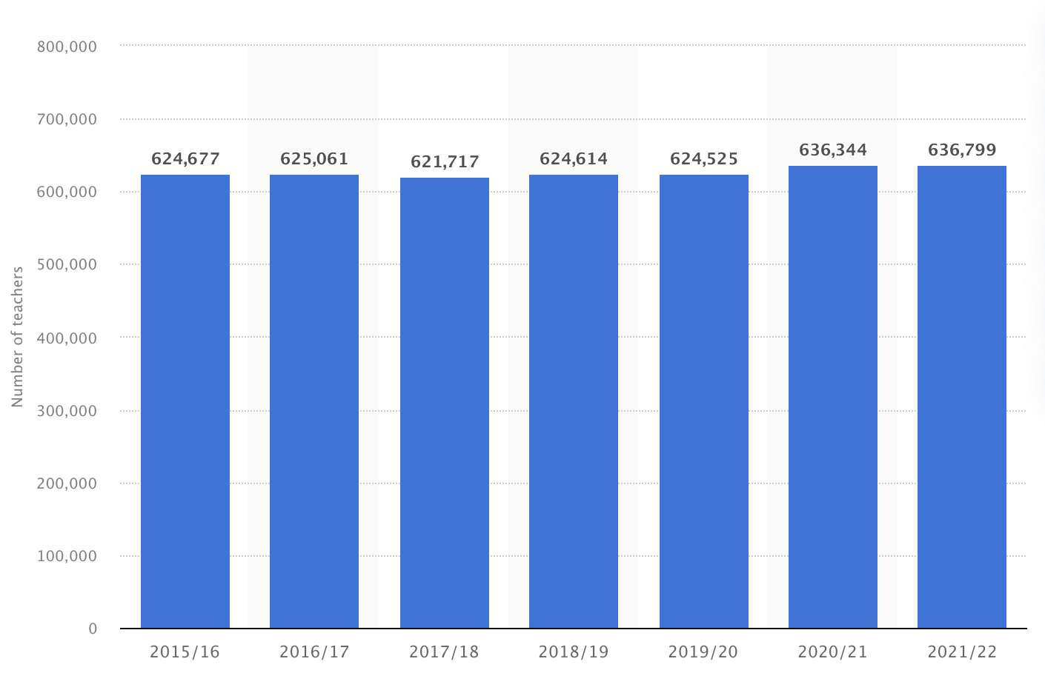
Number of teachers in the UK from 2010/ 2022
In 2021/22 there were over 636,799 full-time equivalent teachers working in the UK, compared with 636,344 in the previous year.
(Published by D. Clark & 7, 2022)

Slide 6
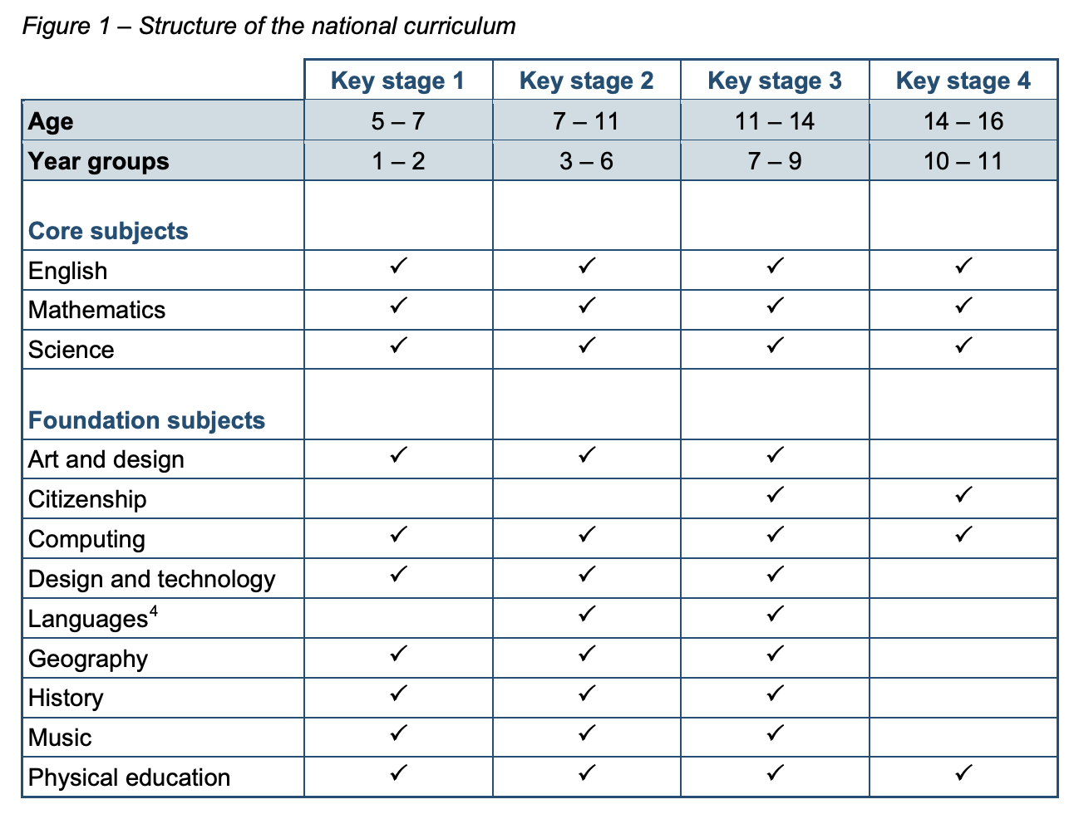
Subject Key Stage Allocation
The structure of the national curriculum in terms of which subjects are compulsory at each key stage is set out in this table.
(GOV.UK,2021)

Slide 7
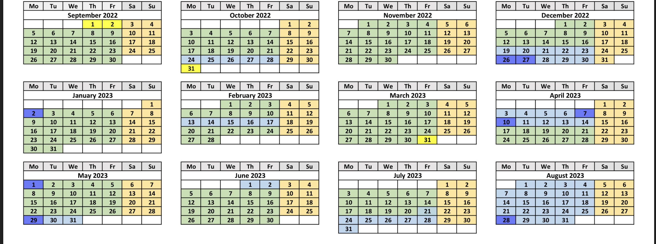
Typical structure of school year
(Moulton school, 2023)
Schools open for 195 days a year
Schools open between 8 – 9 and close between 3 – 4pm.
6 terms (semesters), separated by holidays (vacations)
Holidays/ vacations: Christmas (2 wks); Spring (2 wks); Summer (6 wks); 1 weeks at end of every odd numbered term
School year starts beginning of September
(School holidays in England, 2023)
Notes:
Need some stats on this slide – take from next slide …

Slide 8
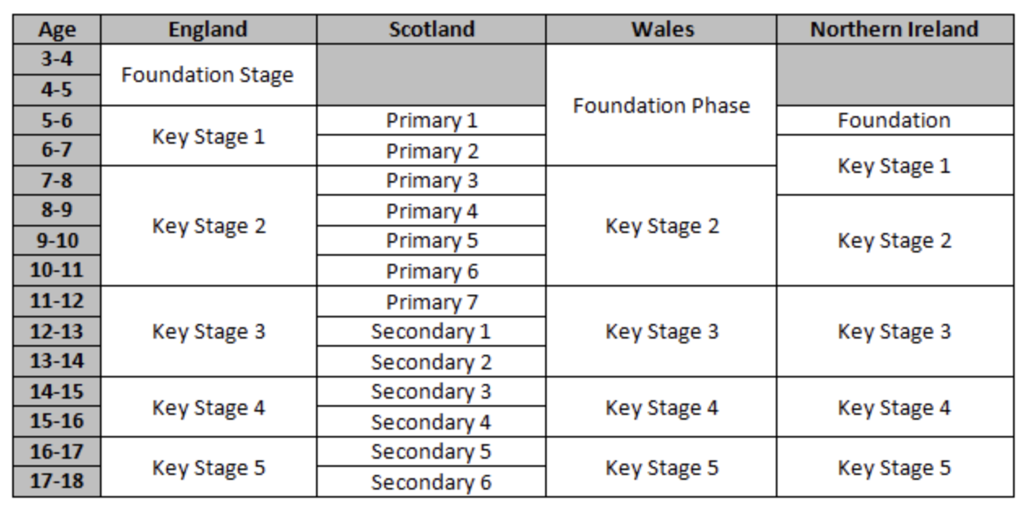
Phases of education
UK education pathway outlined as:
Early Years/ Foundation Stage
Primary
Secondary
Further Education
Higher Education
Adult Education/ Lifelong Learning
There are exceptions, as with any general rule, e.g. full-age schools teaching pupils aged 4 to 18 and some where pupils attend first schools (4 -), middle schools (8-13), then high schools (14-18)
Notes:
Phases of education, broadly speaking, the UK education pathway can be outlined as follows:
Early Years/Foundation Stage
Primary
Secondary
Further Education
Higher Education
Adult Education/Lifelong Learning
However, as with any general rule, there are always exceptions, such as full-age schools teaching pupils aged 4 to 18 and some regional anomalies where pupils attend first schools (aged 4-7), middle schools (aged 8-13) then high schools (aged 14-18).
ADD THIS TO YOUR SLIDE

Slide 9
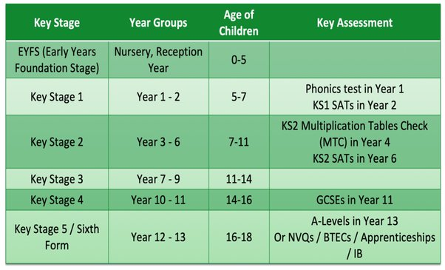
Statutory assessment in Primary
Statutory assessment takes two main forms – teacher assessment and national tests. Currently, we draw on teacher assessment in the reception year and a combination of teacher assessment and national tests in key stages 1 and 2, colloquially known as standard assessment tasks (SATs)
The National Curriculum only extends to pupils in Years 1 to 11 of compulsory education in England. Outside of the statutory National Curriculum assessment in years 2 and 6, the only other centrally collected assessment data is from GCSE exams, usually taken in Year 11. For pupils in other year groups there are no centralised assessments, although schools are free to use tests and examinations either of their own making, or purchased from a supplier.
Notes:
Grammar schools where students admitted on ability.
O-levels continue to thrive as well respected international qualifications for students in other countries, who use them for preparation for advanced study in their own country and/or access higher education overseas
The General Certificate of Education Ordinary Level (O level) was a qualification offered from 1951 until the introduction of the General Certificate of Secondary Education (GCSE) in 1986.

Slide 10
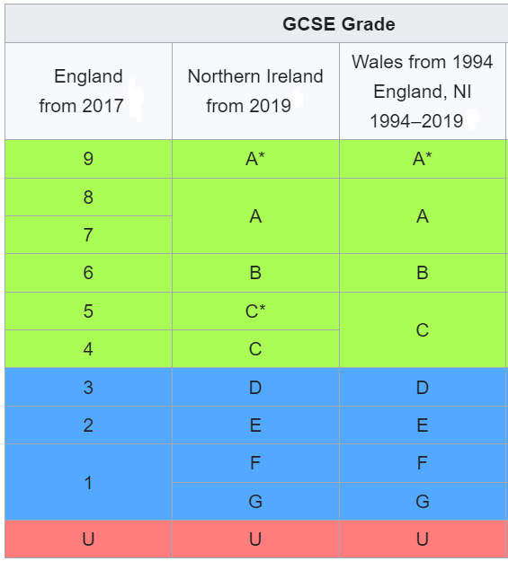
General Certificate of Secondary Education (GCSE)
The General Certificate of Secondary Education (GCSE) is a set of exams taken in England, Wales, Northern Ireland and other British territories. They are usually taken by students aged 15–16 (Key Stage 4), after two years of study (Year 10 and Year 11). GCSEs are the most crucial exams students take before entering college or university. Most students taking their GCSEs study between 5 and 25 subjects.
English, maths, and science are compulsory subjects at the GCSE level.
Most schools require that a pupil passes 5 or more GCSE exams at grades 4 or 5 or above before they can move on to study A-levels.
GCSE grades 9 to 4 (A* to C) – Certificate and qualification awarded. At GCSE, considered a 'standard pass', and awards a qualification at Level 2 of the RQF.
GCSE grades 3 to 1 (D to G) – Certificate and qualification awarded. At GCSE, awards a qualification at Level 1 of the RQF.
U: ungraded/unclassified – no certificate or qualification awarded

Slide 11
England
Education in England is overseen by the Department for Education (DfE)
Independent schools aside, there are six main types of state schools in England:
Community Schools managed by LA who own the buildings and land, employ staff and is responsible for admissions.
Voluntary Controlled Schools typically faith schools where a charitable trust owns the buildings and land, but the local authority employs the staff and manages the admissions process.
Voluntary Aided Schools run by a charitable trust, which may or may not have a religious affiliation. The trust owns the buildings and land, employs the staff and is responsible for admissions.
Foundation Schools are primarily former Grant Maintained Schools. These schools have opted out of LA control so the buildings and land are owned by the governing body or charitable trust and the school employs staff and is responsible for the admissions policy, which is often selective.
Converter and Sponsored Academies are also outside of LA control. The first academies were set-up by the 1997-2010 Labour Government to replace failing community schools. The subsequent coalition government then expanded that programme to allow any school to become an academy.
Free Schools essentially newly-established academies in areas where the need for additional provision is required. Like academies, they receive central government funding, but may be created and run by parents, charities, community groups or businesses.
(educationcompany, 2023)

Slide 12
Scotland
Education Scotland is responsible for education north of the border.
The school system in Scotland is far simpler, with just state or independent schools.
There are a handful of exceptions, called ‘grant-aided schools’, which are privately-run with contributory funding by Education Scotland. These are typically special schools.
(educationcompany, 2023)
Notes:
Add flag

Slide 13
Wales
The Welsh Assembly’s education remit is overseen by the Department for Education and Skills (DfES).
Like Scotland, the structure of school governance in Wales is far simpler than in England. However, there have been a number of senior politicians and education commentators speak out in favour of introducing academies in Wales.
(educationcompany, 2023)
Notes:
What is the difference between an academy and a school?
Academies receive funding directly from the government and are run by an academy trust. They have more control over how they do things than community schools. Academies do not charge fees. Academies are inspected by Ofsted.

Slide 14
Northern Island
The Department for Education in Northern Ireland (DENI) is responsible for legislative school-age education policies.
Like England, and primarily due to religious precedents, Northern Ireland’s school governance model is more complex than in Scotland and Wales.
Controlled Schools are typically pre-Twentieth Century Protestant schools now managed by a governing body, but for whom the Education and Library Boards (local authorities) employ the staff. The governors usually include church leaders, but are open to pupils of all faiths.
Catholic Schools are funded by the Council for Catholic Maintained Schools (CCMS) and educate just over half of the Northern Ireland’s children.
The Northern Ireland Council for Integrated Education (NICIE) promotes and supports the establishment of Integrated Schools by parents and community groups. These schools are open to children of any or no faith and teach in English.
(educationcompany, 2023)
Notes:
There are currently two types of Irish/Gaelic-Medium Schools in Northern Ireland – stand-alone schools and units attached to English-medium schools. This is also known as ‘immersion education’ and is a successful means to achieving bilingualism. In the minority, these schools may apply for central education grants as voluntary-maintained organisations.

Slide 15
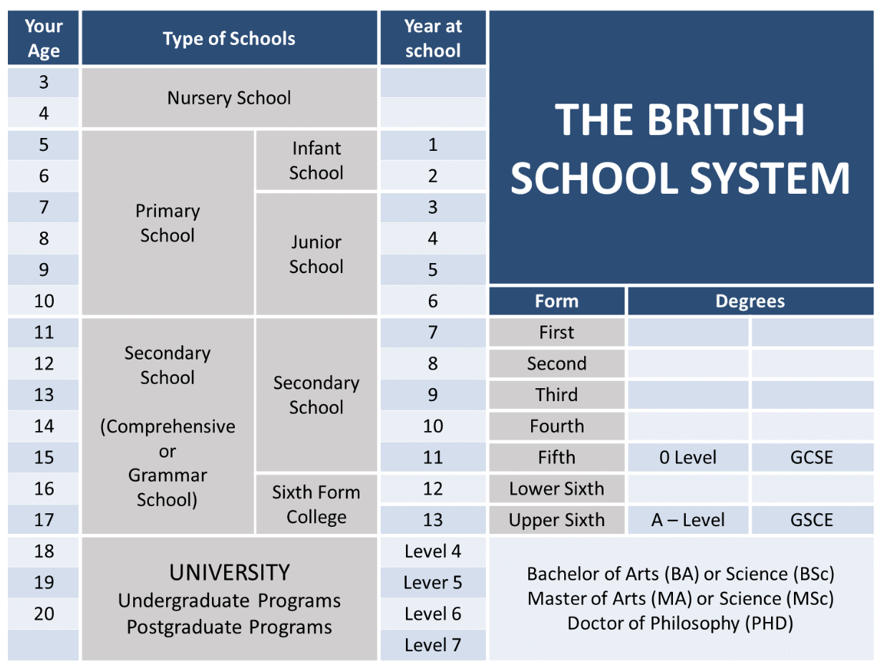
Primary and Secondary Education Pathways
In the UK 93% of the children in England and Wales go to "state schools".
Parents are expected to make sure that their child has a pen, pencil, ruler etc. but the cost of other more specialized equipment, books, examination fees are covered by the school.
Parents are, however, expected to pay for their child's school uniform and items of sportswear.
Charges may also be made for music lessons and for board and lodgings on residential trips.
Schools may ask for voluntary contributions for school time activities - but no pupil may be left out of an activity if their parents or guardian cannot or do not contribute.
(Nikolova, 2021)
Notes:
Grammar schools where students admitted on ability.
O-levels continue to thrive as well respected international qualifications for students in other countries, who use them for preparation for advanced study in their own country and/or access higher education overseas
The General Certificate of Education Ordinary Level (O level) was a qualification offered from 1951 until the introduction of the General Certificate of Secondary Education (GCSE) in 1986.

Slide 16
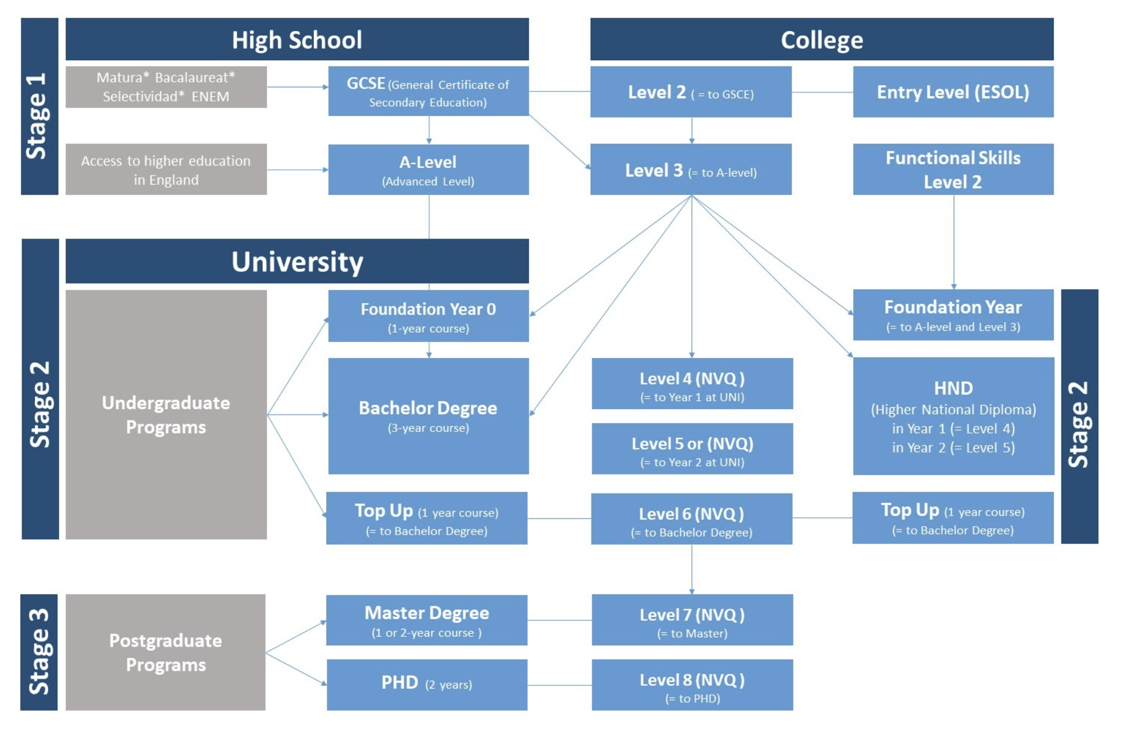
Secondary and primary education
Around 30% of the 18 to 19-year-olds enter full-time higher education.
The formal entry requirements to most degree courses are two A-levels at grade E or above. In practice, most offers of places require qualifications in excess of this.
(Nikolova, 2021)
Notes:
HND example courses:
agriculture.
computing and IT.
construction and civil engineering.
engineering.
health and social care.
business and management.
sport and exercise sciences.
performing arts.

Slide 18
(routesintoteaching, 2023)

Slide 19
Teacher Standards
(Education, 2021)

Slide 20
Thanks for listening!

Slide 21
References
Education, D.for (2021) Teachers' standards, GOV.UK. GOV.UK. Available at: https://www.gov.uk/government/publications/teachers-standards (Accessed: February 27, 2023).
FE News: The Future of Education News Channel, 2020. Close To Two Thirds Of Teachers Considering Leaving Profession Due To Poor Wellbeing. [online] Available at: <https://www.fenews.co.uk/press-releases/58218-close-to-two-thirds-of-teachers-considering-leaving-profession-due-to-poor-wellbeing> [Accessed 23 December 2020].
Fleck, A. and Richter, F. (2022) Infographic: How student-teacher ratios vary across the globe, Statista Infographics. Available at: https://www.statista.com/chart/28158/student-teacher-ratio-in-selected-countries/ (Accessed: February 27, 2023).
Gibb, N., 2012. House Of Commons - Great Teachers: Attracting, Training And Retaining The Best - Education Committee. [online] Publications.parliament.uk. Available at: <https://publications.parliament.uk/pa/cm201012/cmselect/cmeduc/1515/151502.htm> [Accessed 30 November 2020].
Ho, A. and Kane, T., 2013. The Reliability Of Classroom Observations By School Personnel. [online] Files.eric.ed.gov. Available at: <https://files.eric.ed.gov/fulltext/ED540957.pdf> [Accessed 15 November 2020].
Neu.org.uk (no date). Available at: https://neu.org.uk/media/22766/view (Accessed: February 27, 2023).
Nikolova, N. (2021) British education system and equivalency, Study in the UK with UNI Britannica. Available at: https://unibritannica.com/british-education-system-and-equivalency/ (Accessed: February 27, 2023).
Organisations (no date) The Education Company. Available at: https://www.educationcompany.co.uk/knowledge-bank/uk-education-data/organisations/ (Accessed: February 27, 2023).
Organisations (no date) The Education Company. Available at: https://www.educationcompany.co.uk/knowledge-bank/uk-education-data/organisations/ (Accessed: February 27, 2023).
Primary national curriculum - GOV.UK (no date) The Natioanl Curriculum in England. Department for Education. Available at: https://assets.publishing.service.gov.uk/government/uploads/system/uploads/attachment_data/file/425601/PRIMARY_national_curriculum.pdf (Accessed: February 28, 2023).
Published by D. Clark and 24, N. (2022) Schools in the UK 2022, Statista. Available at: https://www.statista.com/statistics/283575/number-of-schools-in-the-united-kingdom/ (Accessed: February 27, 2023).
Published by D. Clark and 7, D. (2022) Full-time teachers in the UK 2022, Statista. Available at: https://www.statista.com/statistics/478929/teachers-in-the-uk/ (Accessed: February 27, 2023).
Routes into teaching : Which paths can trainees take? (no date). Available at: https://www.tes.com/tesv2/files/instituteblog-inline/tes_institute_-routes_into_teaching_infographic.pdf (Accessed: February 27, 2023).
School holidays in England (no date) image: Title. Available at: http://projectbritain.com/education/terms.html (Accessed: February 27, 2023).
Term dates and events (no date) MOULTON SCHOOL. Moulton School. Available at: https://www.moultonschool.co.uk/home/parents/key-information/term-dates-and-events/ (Accessed: February 27, 2023).
The Teachers’ Union - nasuwt.org.uk (no date). Available at: https://www.nasuwt.org.uk/static/c4b7b523-eeb7-4f92-bd1fa0d8d97bb250/Teachers-Pay-Scales-2022-England-exc-London.pdf (Accessed: February 27, 2023).
Uk.sagepub.com. 2009. REFLECTION AND REFLEXIVITY: WHAT AND WHY. [online] Available at: <https://uk.sagepub.com/sites/default/files/upm-binaries/32441_01_Bolton_3e_Ch_01.pdf> [Accessed 29 December 2020].

