Slide 1
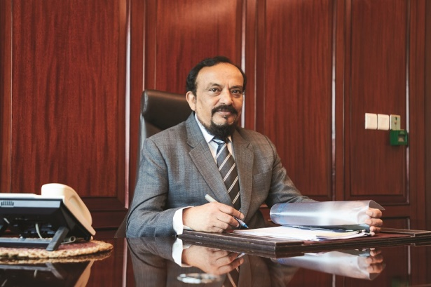
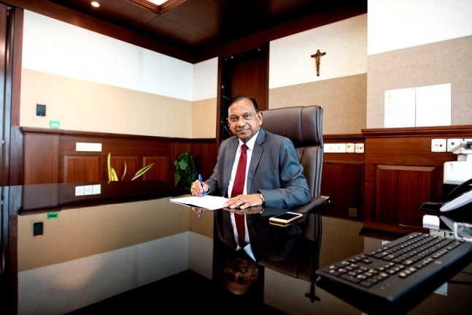
The Council For The Indian school Certificate Examinations
G. Immanuel
(Chairman )
Gerry Arathoon
(Chief Executive and Secretary )

Slide 2
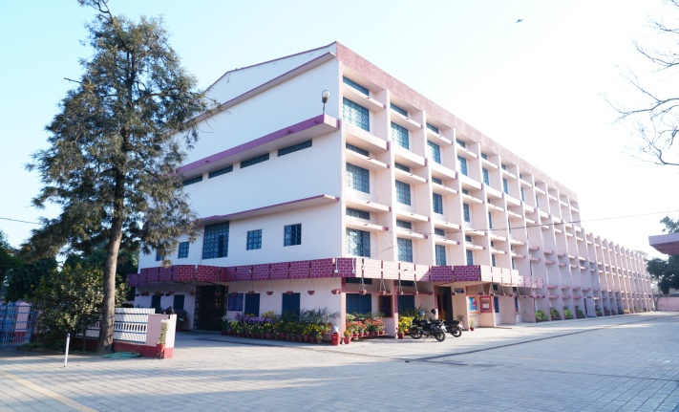
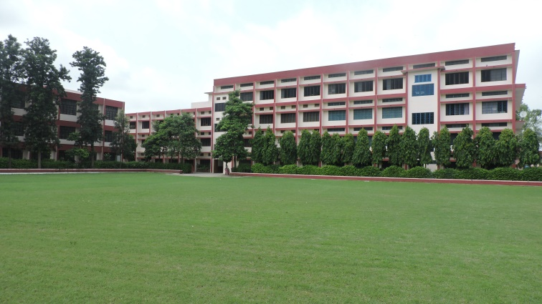
St. Jude’s Convent school Nakodar
Co-ed School Affiliated to Council For Indian School Certificate Examinations (CISCE)
OUR MOTTO
LOVE
LEARN
LIGHT

Slide 3
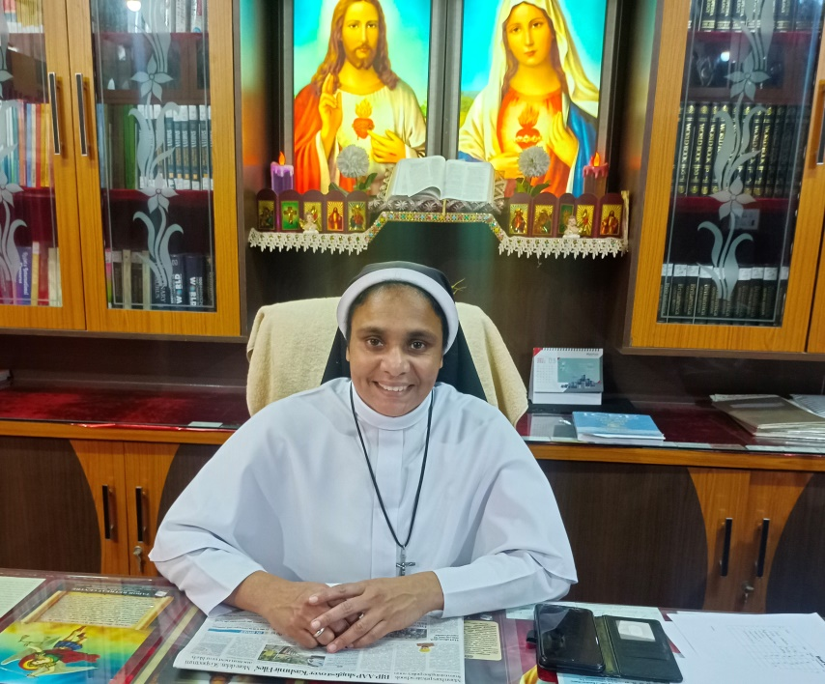
Rev. Sr. Divya
Principal, St. Jude’s Convent School Nakodar

Slide 4
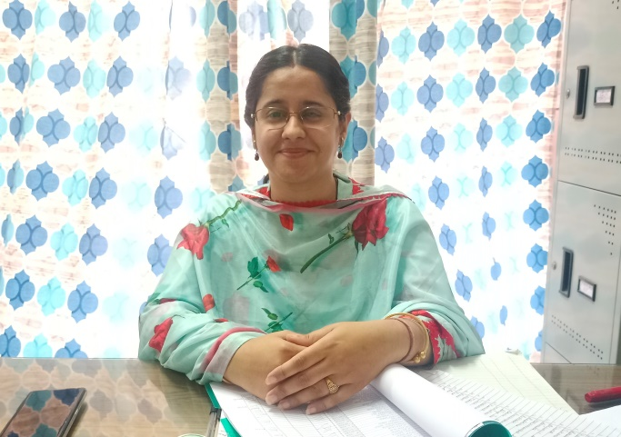
Mrs. Mansi
M.A English Hons.
Phonetics and Linguistics, B.Ed
English Teacher
St. Jude’s Convent School Nakodar

Slide 5
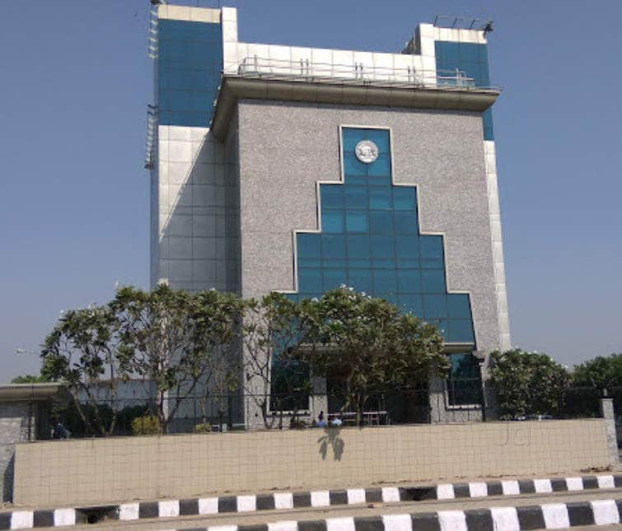
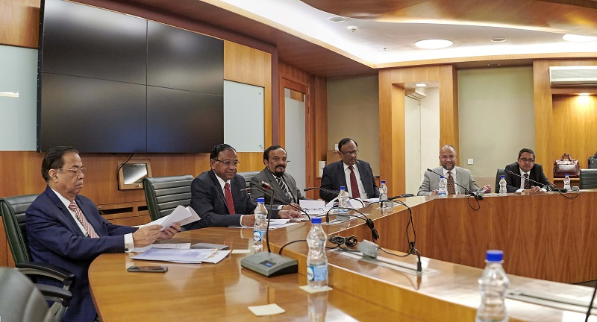
About The Council
Established in 1958
For Anglo-Indian Education
Registered Under The Societies Registration Act No. XXI of 1860
Knowledge is Power

Slide 6
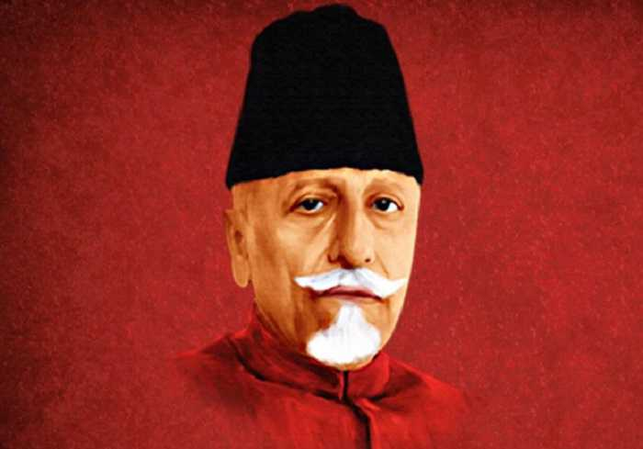
Early Beginnings
Maulana Abul Kalam Azad
In 1952, an All India Certificate Examinations Conference was held under the Chairmanship of “Maulana Abul Kalam Azad”, “Minister for Education”.
In October 1956 at the meeting of the Inter-State Board for Anglo-Indian Education, a proposal was adopted for the setting up of an Indian Council to administer the University of Cambridge.
In December 1967, the Council was registered as a Society under the Societies Registration Act, 1860.
In 1973, the Council was listed in the Delhi School Education Act 1973, as a body conducting "public" examinations.

Slide 7
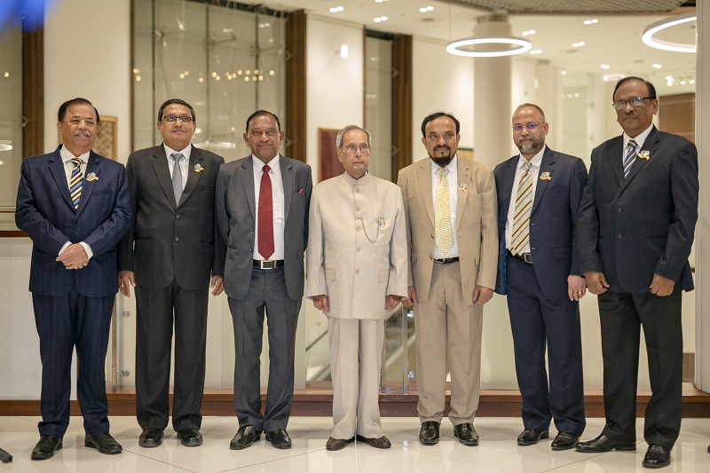
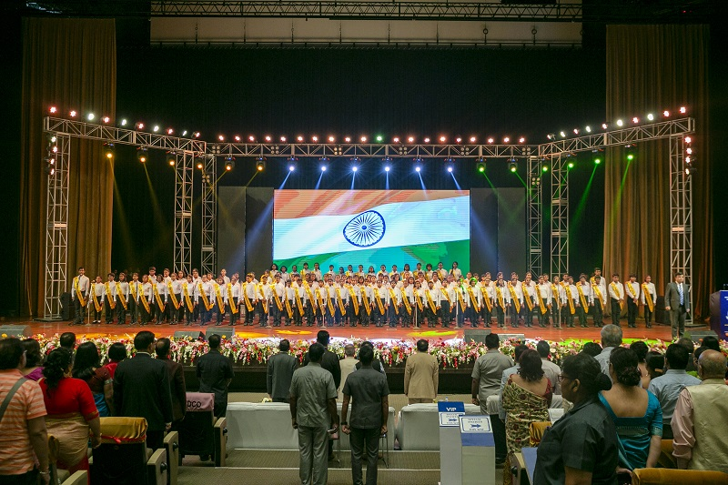
The Council’s Mission
The Council for the Indian School Certificate Examinations is committed to serving the nation's children, through high quality educational endeavours, empowering them to contribute towards a humane, just and pluralistic society, promoting introspective living, by creating exciting learning opportunities, with a commitment to excellence.

Slide 8
The Ethos Of The Council
Trust and fair play.
Minimum monitoring.
Allowing schools to evolve own niche.
Catering to the needs of the children.
Giving freedom to experiment with new ideas and practices.
Diversity and plurality - the basic strength for evolution of ideas.
Schools to motivate pupils towards the cultivation of:
Excellence - The Indian and Global experience.
Values - Spiritual and cultural - to be the bed rock of the educational experience.
Schools to have an 'Indian Ethos', strong roots in the national psyche and be sensitive to national aspirations.

Slide 9
Divisions
Compulsory subjects:
English: Paper 1 and Paper II
General Foundation Industrial Sociology & Entrepreneurship
Choice of subjects:
Mechanical Engineering Technician
Civil Engineering Technician
Telecommunication Engineering Technician
Computer Theory & System Analyst
Business Studies
Air Conditioning and refrigeration
Offset Printing Technician
Graphic Designing Technician
Physical Education
Crèche & Pre-primary School Management
Hospitality Management
Exterior & Interior Design
Office Assistant
THE ICSE (CLASS X)
THE ISC (CLASS XII)
THE C.V.E (YEAR 12)

Slide 10
Regulations & Syllabus
In the ICSE and ISC Board exam pattern, the marking scheme for major subjects will be 80% for external marks and 20% for internal marks.
Because of Covid – 19, The Exam pattern for ICSE & ISC has established new assessment plan which divides the academic year 2021-22
in to two terms:
Term 1 & Term 2

Slide 11
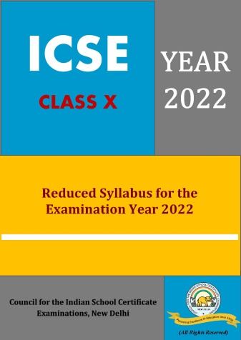
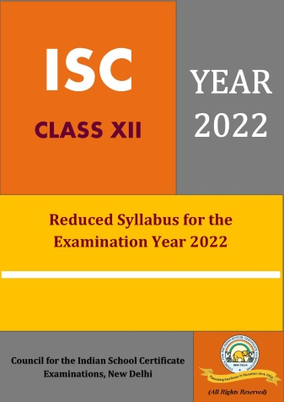
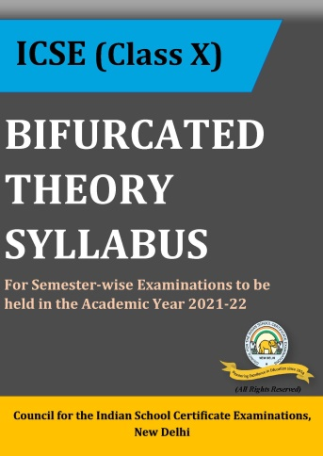
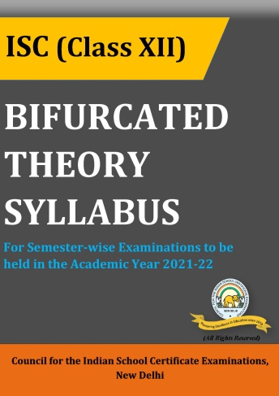
Publications
REDUCED SYLLABUS FOR ICSE & ISC YEAR 2022 EXAMINATION
BIFURCATED THEORY SYLLABUS FOR ICSE (CLASS X) & ISC (CLASS XII) FOR ACADEMIC YEAR 2021-22
CURRICULUM PRE-SCHOOL TO CLASS VIII
RESOURCE MATERIAL ON CISCE CURRICULUM

Slide 12
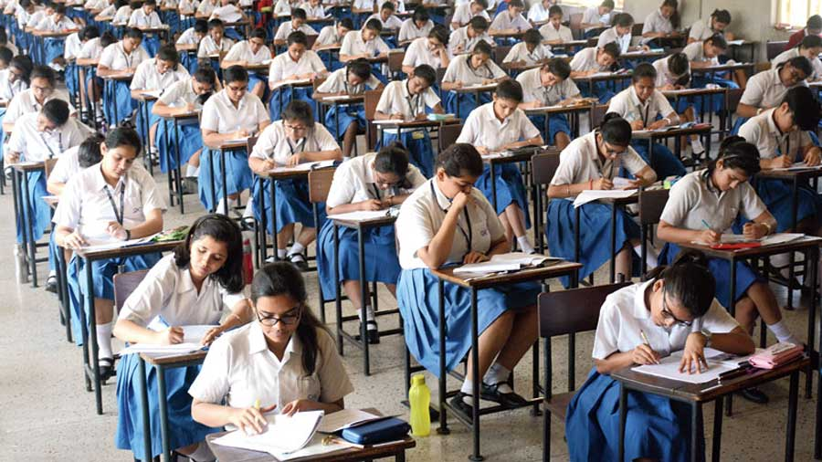
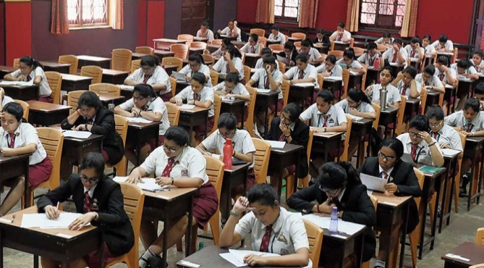
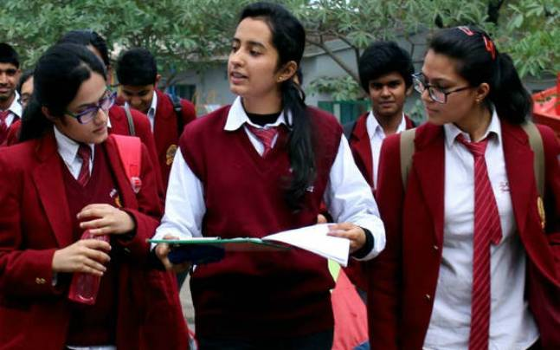
Examinations
THE ICSE (CLASS X)
THE ISC (CLASS XII)
THE C.V.E (YEAR 12)
The C.V.E. course is intended to prepare candidates for specific vocations. Private candidates are not permitted to appear for these examinations.

Slide 13
Exam Criteria
Groups | Subjects under different groups
Group I (80% marks external exam + 20% marks internal exam) | History, Civics, Geography English Second Language (one/two)
Group II (80% marks external exam + 20% marks internal exam) | Science (Physics, Chemistry, Biology) Mathematics Commercial Studies Economics Environmental Science A Classical Language A Modern Foreign Language
Group III (50% marks external exam + 50 % marks internal exam) | Arts Performing Arts Computer Applications Economic Applications Commercial Applications Fashion Designing Physical Education Yoga Cookery Home Science A Modern Foreign Language Technical Drawing Applications Environmental Applications

Slide 14
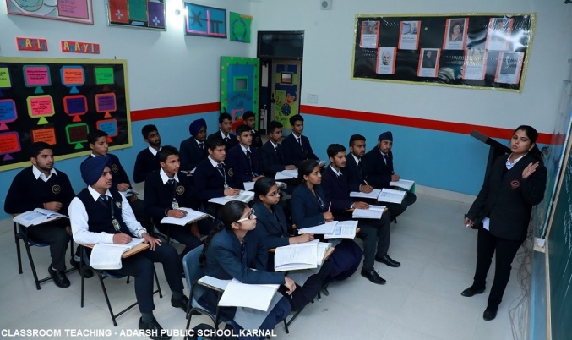
CVE
Certificate Of Vocational Education (Year 12)
The Certificate of Vocational Education Examination (CVE - 12) has been created as an examination, in accordance with the recommendations of the Ministry of Human Resource Development (MHRD) through the Joint Council of Vocational Education (JCVE) established under the National Policy of Education 1986. This examination can be taken by candidates after a two year course of studies beyond the Indian Certificate of Secondary Education (Year 10) examination or its equivalent, through the medium of English.
Regulations
Syllabus
The C.V.E. course is intended to prepare candidates for specific vocations. Private candidates are not permitted to appear for these examinations.

Slide 15
RDCD
Research, Development & Consultancy Division
Curriculum development and review including preparation of the ICSE, ISC and CVE syllabi.
Design and development of Specimen Question Papers.
Development of resource material for teachers and students.
Preparation of the documents entitled "Analysis of Pupil Performance" both at the ICSE and ISC levels.
Preparation of the Council's Quarterly magazine "The Council Record".
Conducting studies based on contemporary broad based academic issues.

Slide 16
National Competitions
The events are conducted in Debate, Declamation, Painting, Creative Writing and Quiz will be conducted in three categories: • Sub juniors (Students of VI, VII and VIII) • Juniors (Students up to X) • Seniors (Students of XI and XII)
The Council conducts, the Frank Anthony Memorial All-India Inter-School Debate and the Albert Barrow Memorial All-India Inter-School Creative Writing competitions, thereby underpinning the critical importance of creativity and the ability to articulate one's thoughts in writing and speech in school education.

Slide 17
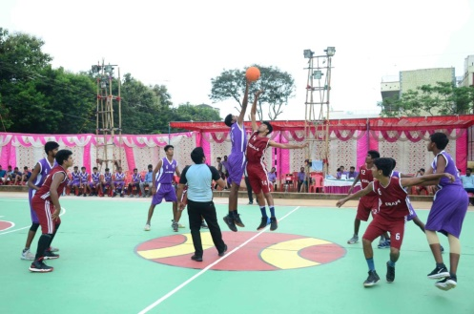
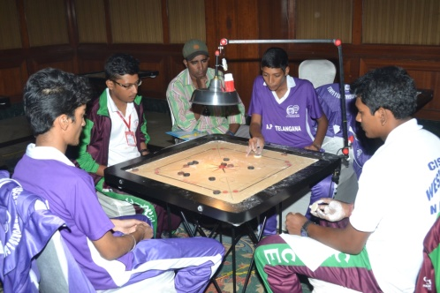
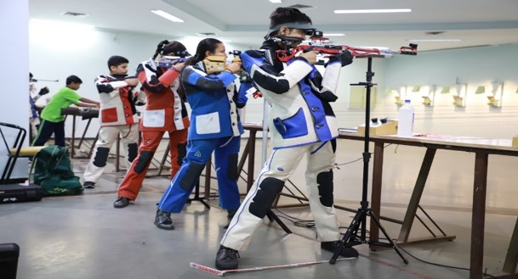
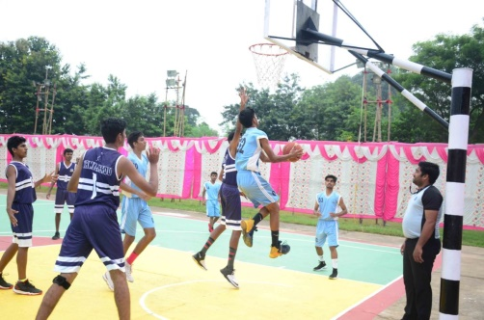
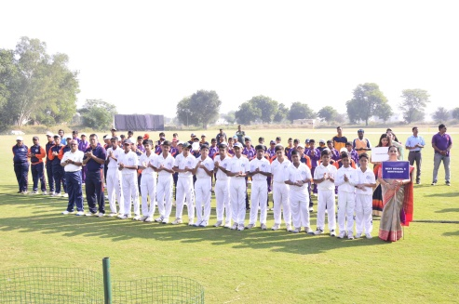
Games & Sports
The Council has therefore embarked on a mission to conduct the ‘Council School Games & Sports’ annually in order to identify talents at the school level and provide these children a suitable platform to develop and reach their full potential. This is also in keeping with the Government’s initiative of identifying sporting talent among children at the school level and developing Sports Schools through the Khelo India School Games and the Khelo India Scheme respectively.

Slide 18
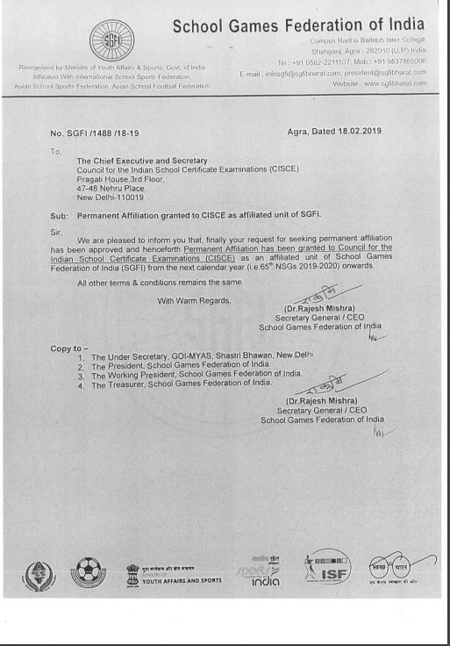
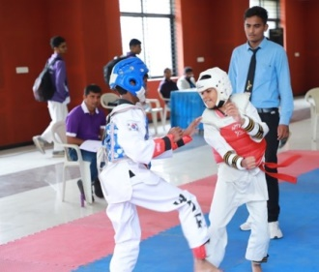
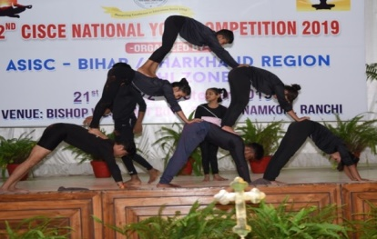
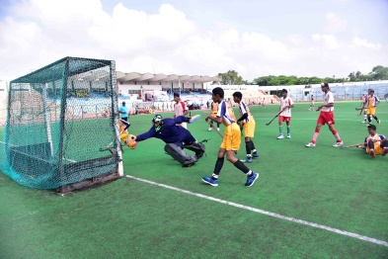
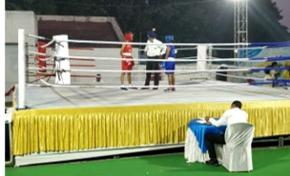
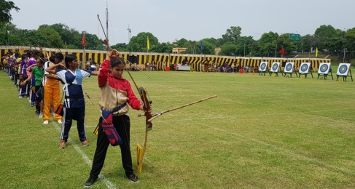
SGFI
School Games Federation of India
65th National School Games 2019-20
Gold Medal – 20
Silver Medal – 16
Bronze Medal - 35

Slide 19
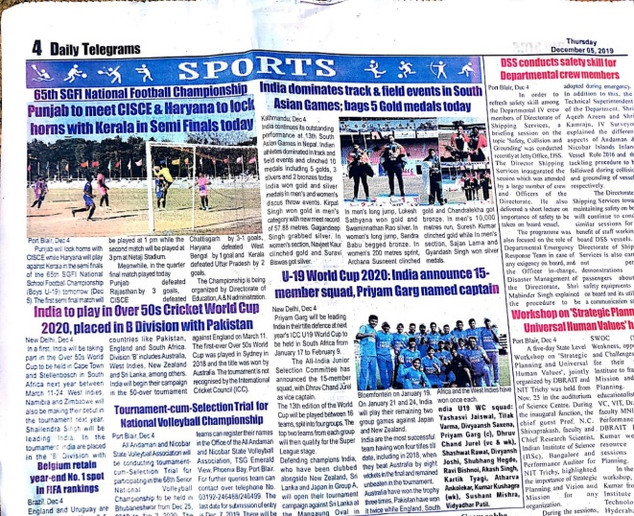
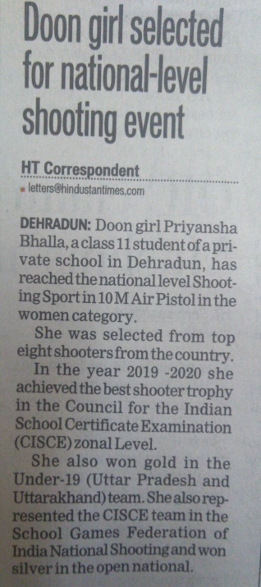
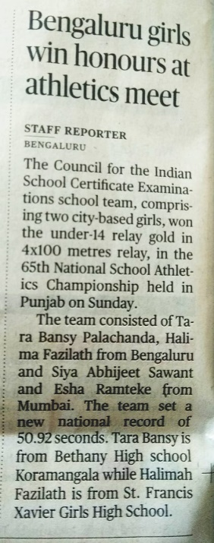
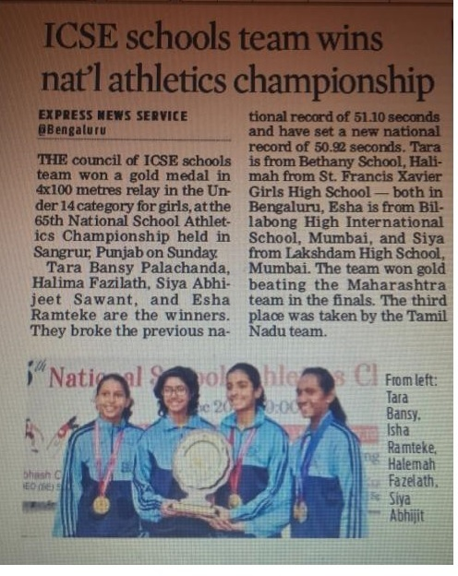
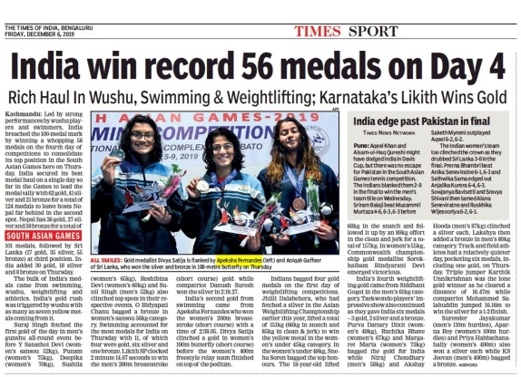
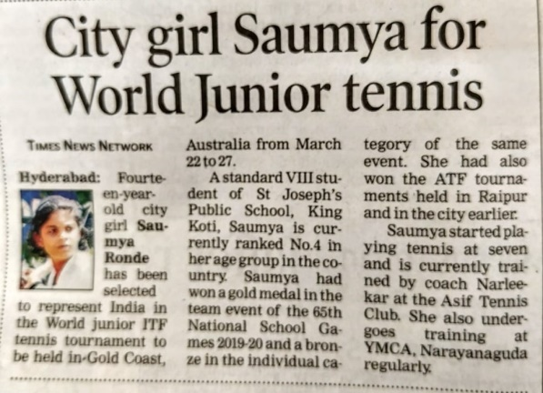
Achievements

Slide 20
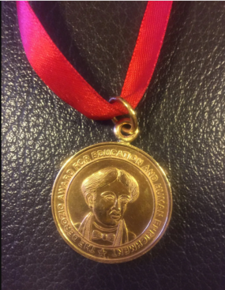
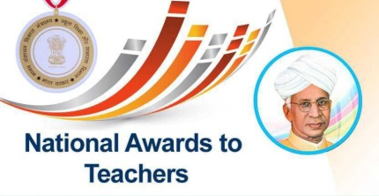
Awards
THE DEROZIO AWARDS
Henry L.V. Derozio (1809 - 1830), arguably the first Indian poet, freedom fighter and social reformer, was fondly referred to as the "National Bard of Modern India.“
NATIONAL AWARDS
SCHEME OF NATIONAL AWARDS TO TEACHERS FROM SCHOOLS AFFILIATED TO COUNCIL FOR THE INDIAN SCHOOL CERTIFICATE EXAMINATIONS - NEW DELHI AWARDS FOR TEACHERS AND PRINCIPALS
ICT AWARD
The Government of India, Ministry of Human Resource Development implemented National Awards for teachers for "Using ICT for Innovations in Education".

Slide 21
Training
Online Teacher Training Programs at the ICSE (Class X) and ISC (Class XII) Levels. - 7 MAR 2022 to 20 APR 2022.
Online Teacher Training Programs at The ICSE Level - 8th Nov. to 12th Nov.
Online Training Programs at The ICSE & ISC Levels.
Nishtha Courses For teachers
Study Material
Training Activities
Website Tutorials
Resources

